Slide 1
Bike-Sharing-Prediction-Linear-Regression-Model

Slide 2
Overview
A bike-sharing system is a service in which bikes are made available for shared use to individuals on a short term basis for a price or free. Many bike share systems allow people to borrow a bike from a "dock" which is usually computer-controlled wherein the user enters the payment information, and the system unlocks it. This bike can then be returned to another dock belonging to the same system.
Business Goal
The objective is to model the demand for shared bikes with the available independent variables. It will be used by the management to understand how exactly the demands vary with different features. They can accordingly manipulate the business strategy to meet the demand levels and meet the customer's expectations. Further, the model will be a good way for management to understand the demand dynamics of a new market.

Slide 3
Steps for Linear Regression
Reading the Data
EDA on the read Data
Inferences from EDA of categorical and numerical variables
Data Preparation
Splitting the data into test and train datasets
Rescaling the feature variables
Checking linearity and correlation in the train dataset after rescaling and dummy field conversion
Building our MLR model
Building our MLR model
Building the model after adding march.
Checking linearity and correlation in the train dataset after rescaling and dummy field conversion

Slide 4
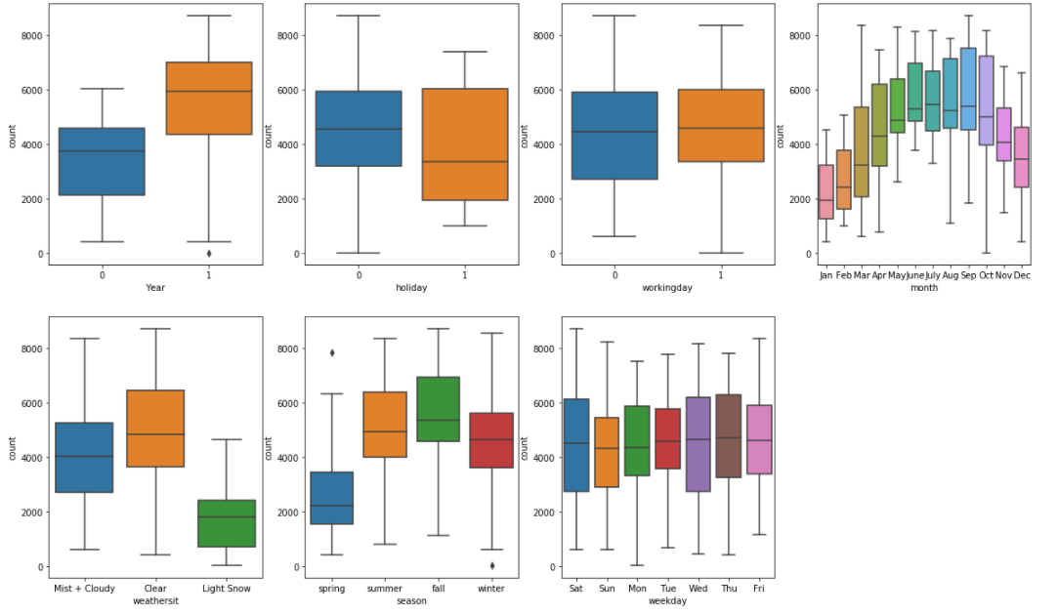
Inferences from EDA of categorical and numerical variables:
Season - We can notice a positive trend in the number of customers in 2 - Summer, 3 - Fall and 4 - Winter seasons
Year - The overall business shows a increasing trend in their user base year on year
Month - Similar to the season trend, there is a postive trend in the months of summer, fall and winter.
Holiday : On holidays, the users show a wider spread in the counts. On normal days, the users are more than holidays
Weekday : Weekdays or weekends do not show any specific trend here.
Weathersit : Clearer weathers show a postive trend in the number of bike users - 1: Clear, Few clouds, Partly cloudy, Partly cloudy - 2: Mist + Cloudy, Mist + Broken clouds, Mist + Few clouds, Mist - 3: Light Snow, Light Rain + Thunderstorm + Scattered clouds, Light Rain + Scattered clouds

Slide 5
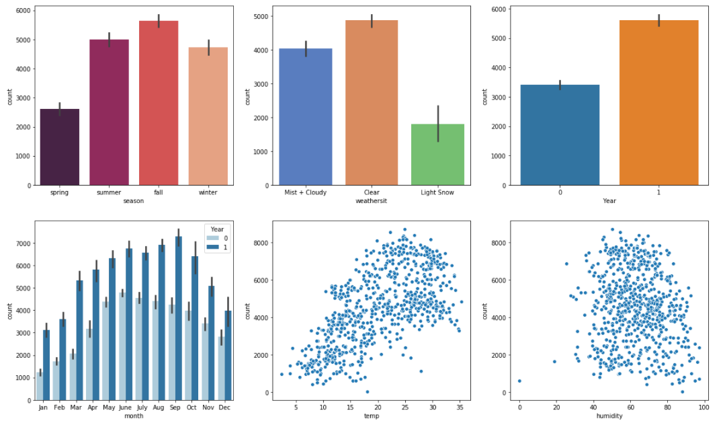
Cont.
Bike Rentals are more during the Fall season and then in summer
Bike Rentals are more in partly cloudy weather
Bike rentals are more in the year 2019 compared to 2018
Bike Rentals are observed at higher temperatures
Bike rentals more at high humidity

Slide 6
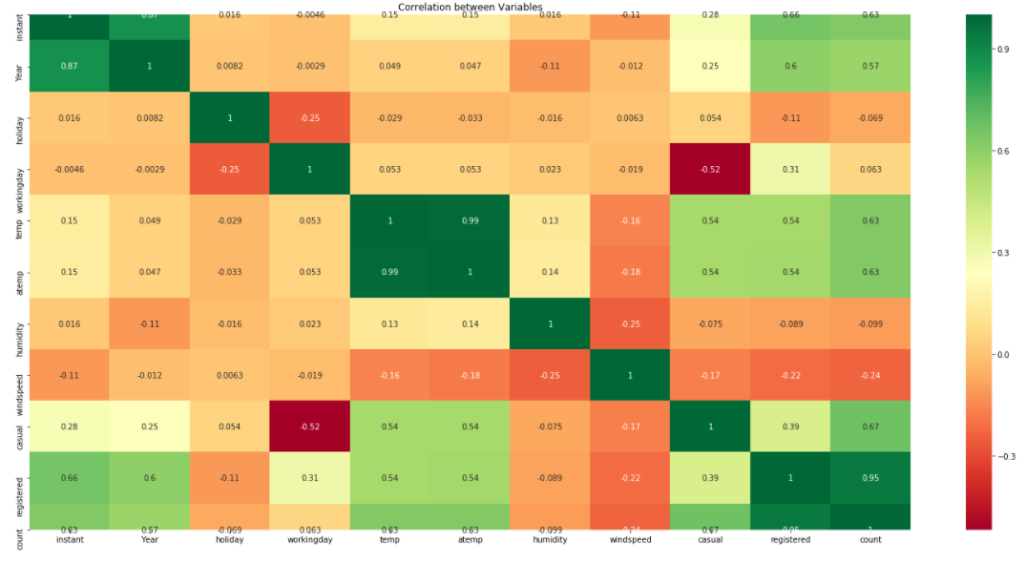
Lightest and Darkest areas show the most co-relation among the variables:
Lightest - Positive correlation
Darkest - Negative correlation
From the heatmap, we can infer that the following variables show the most correlation with the target variable
temperature
season
month
user types; instant, registered and causal and season

Slide 7
Data Preparation
Convert categorical variables into dummy variables
List of categorical variables:
season : 1:spring, 2:summer, 3:fall, 4:winter
Year: 0: 2018, 1:2019
months : 1 to 12
holiday : 0 and 1
Working day : 0 and 1
weekday : 1 to 6
weather sit : 1, 2, 3 and 4
From the list of columns, we do not need to convert year, holiday and working day since they are already in a binary format. We will go ahead with converting the other columns.
Data Consistency
Handling Missing Values
Outlier Analysis /Treating outlier values
Scaling of data
Feature Engineering

Slide 8
Splitting the Data into Training and Testing Sets
Before model building, you first need to perform the test-train split and scale the features.
Rescaling the Features
It is important to have all the variables on the same scale for the model to be easily interpretable. We can use standardization or normalization so that the units of the coefficients obtained are all on the same scale.
There are two common ways of rescaling:
Min-Max scaling (Normalization):Between 0 and 1
Standardization :mean-0, sigma-1
Building a linear model
We will be using the Linear Regression function from SciKit Learn for its compatibility with RFE (which is a utility from sklearn)
RFE (Recursive Feature Elimination)
Checking VIF (Variance Inflation Factor ): gives a basic quantitative idea about how much the feature variables are correlated with each other. It is an extremely important parameter to test our linear model. The formula for calculating VIF is:
VIFi = 1/(1-R^2)
January is insignificant in presence of other variables due to high p-value and low VIF; can be dropped
'humidity' variable can be dropped as its insignificant by looking at very high VIF
Holiday variable seems to be insignificant, by looking at p value and low VIF. We can drop it
Windspeed seems to be insignificant, by looking at high VIF and negative correlation with count. Let's drop it
July column can be dropped due to its p value and low VIF
Rebuild the model without January, Humidity, Holiday, Windspeed, temp & July Data
So, our model is lm5 which is obtained by removing January, windspeed, holiday, July and humidity variables from the RFE support columns**

Slide 9
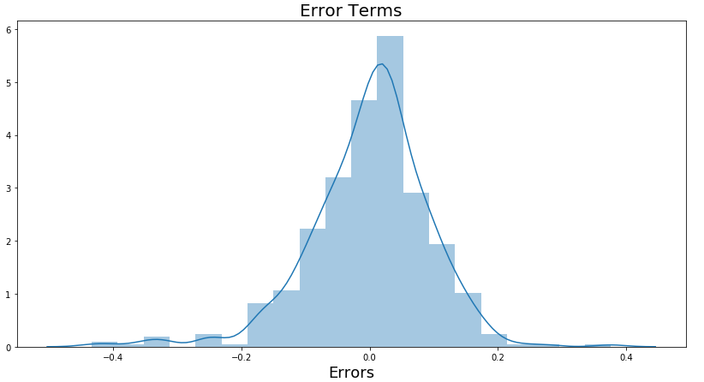
The p values represent the significance of the variables and VIF which represent how variables are correlated to each other. Based on these two parameters we decided which variable to drop.
The VIFs and p-values both are within an acceptable range. So we go ahead and make our predictions using this model only.
The p-value for each term tests the null hypothesis that the coefficient is equal to zero (no effect). A low p-value (< 0.05) indicates that you can reject the null hypothesis.
A rule of thumb commonly used in practice is if a VIF is > 10, you have high multicollinearity. In our case, with values less than 5, we are in good shape, and can proceed with our regression
R-squared measures the strength of the relationship between your model and the dependent variable on a convenient 0 – 100% scale. And we have the R-square value of 0.826 or 82.6%
The adjusted R-squared adjusts for the number of terms in the model. And we got it around 0.82 or 82%
Step 6: Residual Analysis of the train data

Slide 10
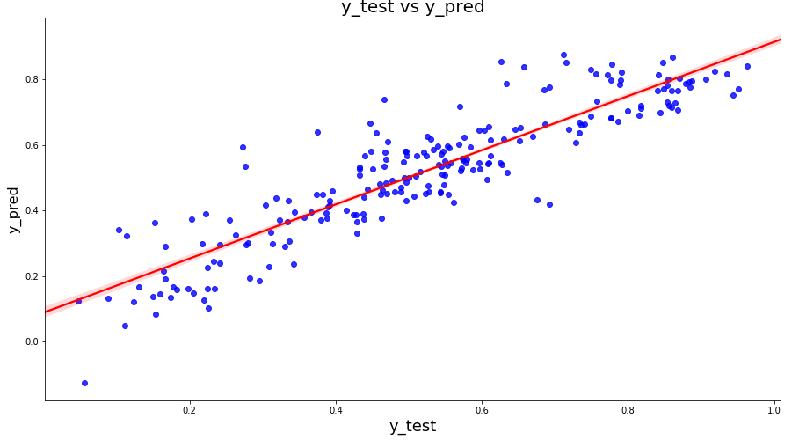
Step 7: Making Predictions
We can see that the equation of our best fitted line is:
count=0.4914×temp+0.0916×September+0.0645×Saturday+0.0527×summer+0.0970×winter+0.2334×Year +0.0566×workingday−0.03041×lightsnow−0.0786×mistcloudy−0.065×spring
Final Result Comparison between Train model and Test:
Train R^2 : 0.826
Train Adjusted R^2 : 0.82
Test R^2: 0.8115
Test Adjusted R^2: 0.790564
Difference in R^2 between train and test: 1.5%
Difference in adjusted R^2 between Train and test: 3.15% which is less than 5%
Interpretation:
We arrived at a very decent model for the the demand for shared bikes with the significant variables
We can see that temperature variable is having the highest coefficient 0.4914, which means if the temperature increases by one unit the number of bike rentals increases by 0.4914 units.
Similarly, we can see coefficients of other variables in the equation for best fitted line.
We also see there are some variables with negative coefficients, A negative coefficient suggests that as the independent variable increases, the dependent variable tends to decrease. We have spring, mist cloudy , light snow variables with negative coefficient. The coefficient value signifies how much the mean of the dependent variable changes given a one-unit shift in the independent variable while holding other variables in the model constant.

